Slide 1
Object Oriented Programming

Slide 2
Agenda
Python for Business: Automating, Analyzing & Making Smarter Decisions
Introduction to OOP
Importance of OOP in fintech.
Installation and setup of Jupyter Notebook
Starting Python and OOP

Slide 3

Let’s get to know Each other 😉

Slide 4

“Welcome Back — Let’s Start Where We Left Off”
Name + one good thing you remember from last semester
One thing you’re interested in outside academics
One thing you want to learn/master this semester
What should I do as your instructor to make this semester better?

Slide 5

1.1 : What is OOP?

Slide 6
OOP stands for Object-Oriented Programming.
Object-Oriented Programming is a way of writing programs by modeling real-world entities as objects.
Python is an object-oriented language, allowing you to structure your code
using classes and objects for better organization and reusability.

Slide 7
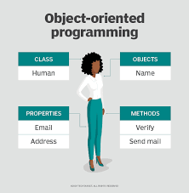

Slide 8
1.2
IMPORTANCE OF OOP
Provides a clear structure to programs
Makes code easier to maintain, reuse, and debug
Helps keep your code DRY (Don't Repeat Yourself)
Allows you to build reusable applications with less code

Slide 9
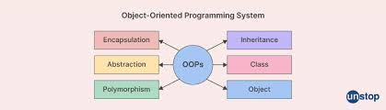

Slide 10
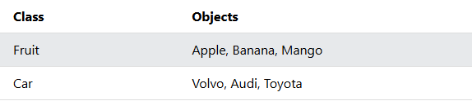
CLASS | OBJECT
A class defines what an object should look like, and an object is created based on that class.

Slide 11
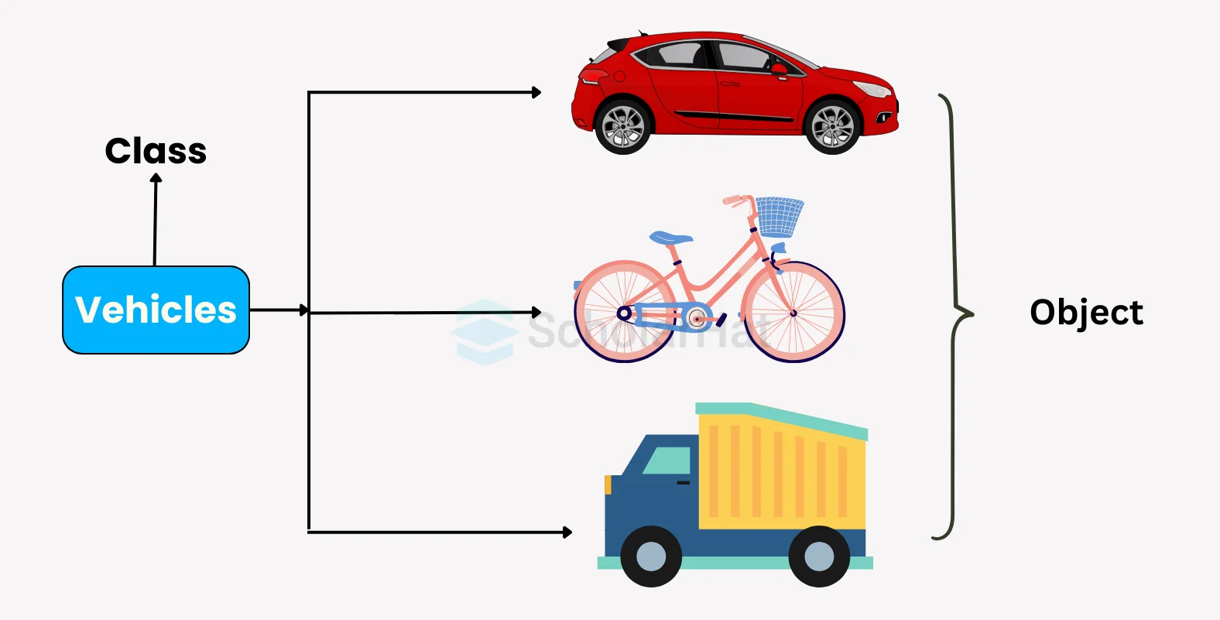

Slide 12
1.3 Importance of OOP in FinTech
Banking software
Wallet apps (Easypaisa, JazzCash)
Trading systems
Payment gateways

Slide 13
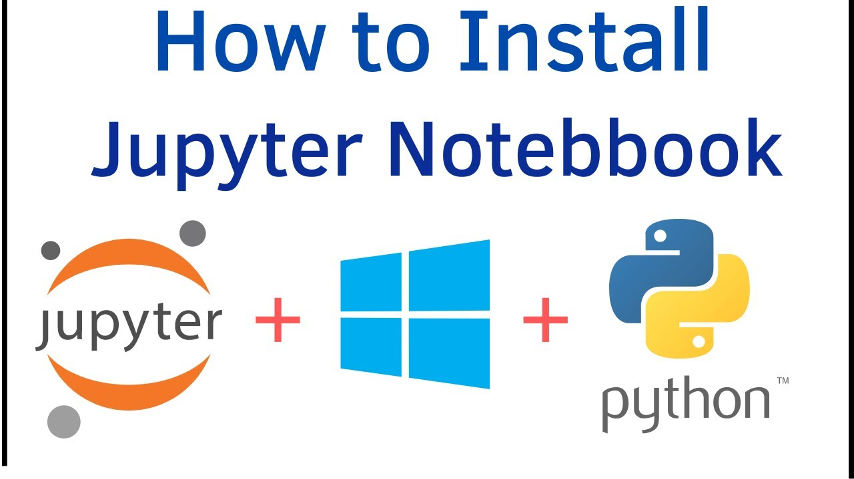

Slide 14
1.4 procedural vs. OOP
Task : A BANK ACCOUNT MANAGEMENT
A bank wants a simple program to manage customer bank accounts.
The program should store information about a customer's name, account number, and balance.
The program should allow the user to:
Create an account
Deposit money
Withdraw money
Check account balance
Display customer information
For withdrawal, the program should check whether the customer has sufficient balance. If the balance is insufficient, display an appropriate message.
Notes:
name = "Ali"
account_number = "ACC101"
balance = 10000
def deposit(balance, amount):
return balance + amount
def withdraw(balance, amount):
if amount <= balance:
return balance - amount
else:
print("Insufficient balance")
return balance
balance = deposit(balance, 5000)
balance = withdraw(balance, 2000)

Slide 15
WHAT SEEMS TO BE THE PROBLEM ??

Slide 16
What information does a bank account have?
What can a bank account do?

Slide 17
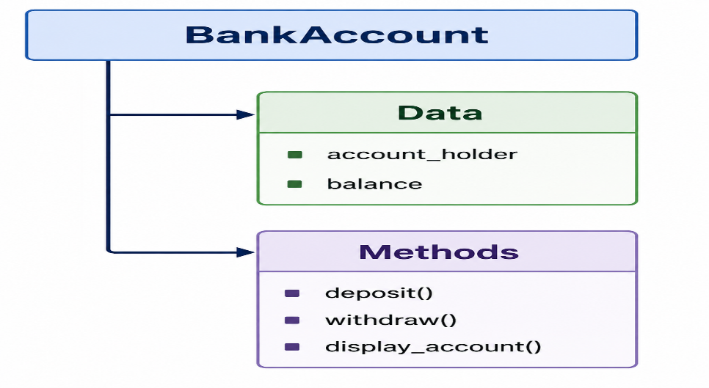
Here, the data and functions that operate on the data are handled separately.
Where as , OOP programming paradigm where a program is organized around objects that combine data and behavior and data and functions are bundled together inside a class.

Slide 18
Oop uses classes and Objects.
Attributes
owner
account_number
balance
Methods
deposit()
withdraw()
check_balance()
display_account()
Notes:
class BankAccount:
def __init__(self, owner, account_number, balance):
self.owner = owner
self.account_number = account_number
self.balance = balance
def deposit(self, amount):
self.balance += amount
print("Amount deposited successfully.")
def withdraw(self, amount):
if amount <= self.balance:
self.balance -= amount
print("Amount withdrawn successfully.")
else:
print("Insufficient balance.")
def check_balance(self):
print("Current balance:", self.balance)
def display_customer(self):
print("Owner:", self.owner)
print("Account Number:", self.account_number)
print("Balance:", self.balance)
account1 = BankAccount("Ali", "ACC101", 10000)
account1.deposit(5000)
account1.withdraw(2000)
account1.display_customer()

Slide 19
TASKS
Task 1 A BANK ACCOUNT MANAGEMENT
A bank wants a simple program to manage customer bank accounts.
The program should store information about a customer's name, account number, and balance.
The program should allow the user to:
Create an account
Deposit money
Withdraw money
Check account balance
Display customer information
For withdrawal, the program should check whether the customer has sufficient balance. If the balance is insufficient, display an appropriate message. And Create 10 accounts and show All Accounts Summery in Last

Slide 20
Task 2 — Number Analysis
Concepts: for loop, while loop, conditions
Write a Python program that asks the user to enter 10 numbers.
Your program should:
Store the numbers.
Count how many numbers are positive.
Count how many are negative.
Count how many are zero.
Calculate the sum of all numbers.
Find the largest number.
Find the smallest number.
Do not use max() or min().

Slide 21
Task 3 — Student Marks List
Concepts: List, loops, conditions
Create a program that asks the user to enter marks of 10 students and stores them in a list.
The program should display:
All marks
Highest marks
Lowest marks
Average marks
Number of students who passed
Number of students who failed

Slide 22
Task 4 — Shopping List
Concepts: Lists, loops, conditions
Create a simple shopping program.
The user should enter 5 products and their prices.
Store the products and prices in lists.
Then calculate:
Total bill
Most expensive product
Cheapest product
Average product price

Slide 23
Task 5 — Tuple-Based Student Record
Concepts: Tuple, list, loops
Create student records using tuples.
Store these tuples inside a list:
Your program should:
Display all students.
Display only student names.
Display students whose age is greater than 20.
Count the number of students.
Search for a student by name.

Slide 24
Task 6 — Functions-Based Calculator
Concepts: Functions, conditions, loops
Create a calculator using separate functions:
Display a menu:
Addition
Subtraction
Multiplication
Division
Exit
The program should continue running until the user selects Exit.
Division by zero must be handled.

Slide 25
Thank you
Shahzaib Shaikh
Email: shahzaib.shaikh@nu.edu.pk

